Slide 1
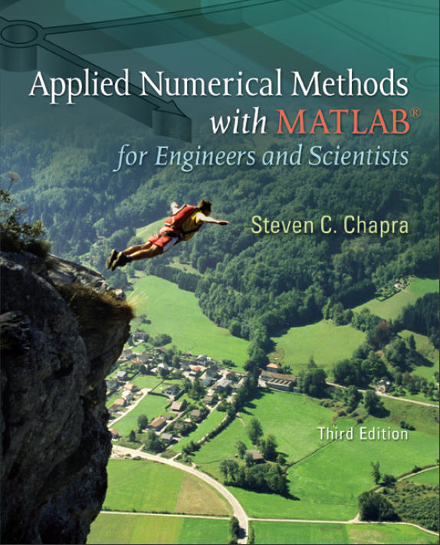
Part 2
Chapter 5
Roots: Bracketing Methods
PowerPoints organized by Dr. Michael R. Gustafson II, Duke University
All images copyright © The McGraw-Hill Companies, Inc. Permission required for reproduction or display.

Slide 2
Chapter Objectives
Understanding what roots problems are and where they occur in engineering and science.
Knowing how to determine a root graphically.
Understanding the incremental search method and its shortcomings.
Knowing how to solve a roots problem with the bisection method.
Knowing how to estimate the error of bisection and why it differs from error estimates for other types of root location algorithms.
Understanding false position and how it differs from bisection.

Slide 3
Roots
“Roots” problems occur when some function f can be written in terms of one or more dependent variables x, where the solutions to f(x)=0 yields the solution to the problem.
These problems often occur when a design problem presents an implicit equation for a required parameter.

Slide 4
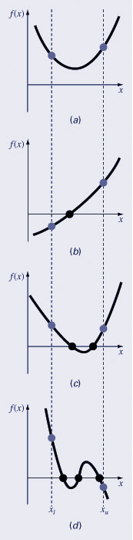
Graphical Methods
A simple method for obtaining the estimate of the root of the equation f(x)=0 is to make a plot of the function and observe where it crosses the x-axis.
Graphing the function can also indicate where roots may be and where some root-finding methods may fail:
  Same sign, no roots
  Different sign, one root
  Same sign, two roots
  Different sign, three roots

Slide 5
Bracketing Methods
Bracketing methods are based on making two initial guesses that “bracket” the root - that is, are on either side of the root.
Brackets are formed by finding two guesses x_{l} and x_{u} where the sign of the function changes; that is, where f(x_{l} ) f(x_{u} ) < 0
The incremental search method tests the value of the function at evenly spaced intervals and finds brackets by identifying function sign changes between neighboring points.

Slide 6
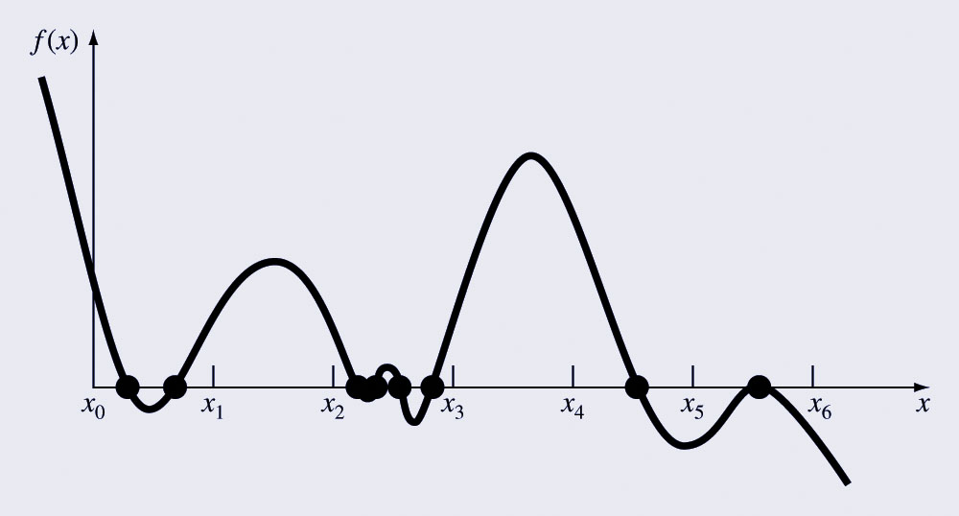
Incremental Search Hazards
If the spacing between the points of an incremental search are too far apart, brackets may be missed due to capturing an even number of roots within two points.
Incremental searches cannot find brackets containing even-multiplicity roots regardless of spacing.

Slide 7
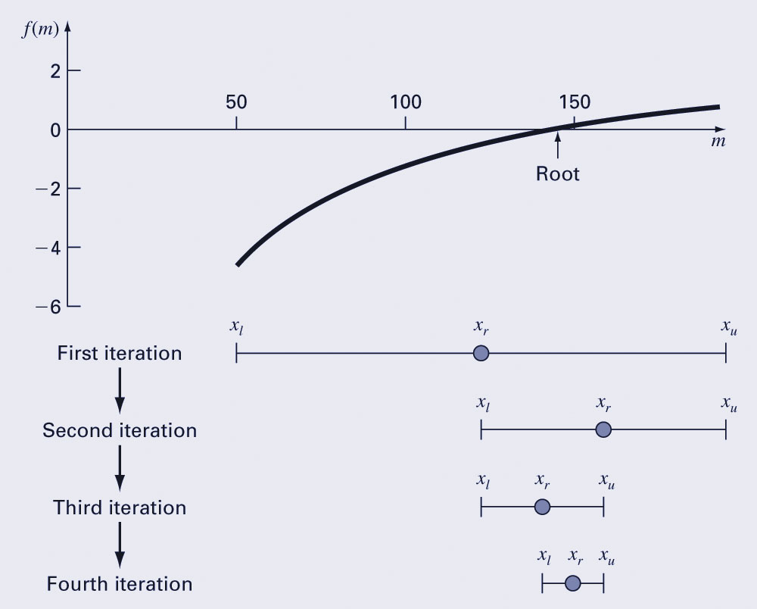
Bisection
The bisection method is a variation of the incremental search method in which the interval is always divided in half.
If a function changes sign over an interval, the function value at the midpoint is evaluated.
The location of the root is then determined as lying within the subinterval where the sign change occurs.
The absolute error is reduced by a factor of 2 for each iteration.

Slide 8
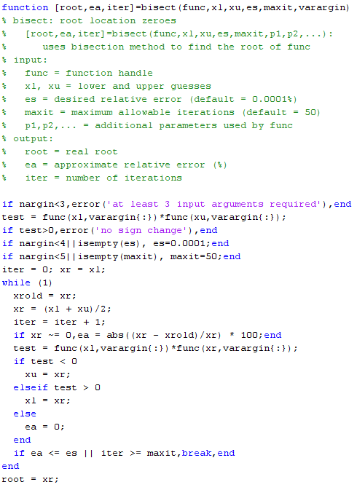
Programming Bisection

Slide 9
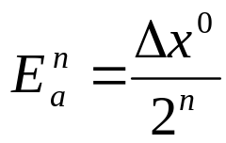
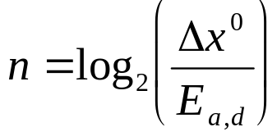
Bisection Error
The absolute error of the bisection method is solely dependent on the absolute error at the start of the process (the space between the two guesses) and the number of iterations:
The required number of iterations to obtain a particular absolute error can be calculated based on the initial guesses:

Slide 10
False Position
The false position method is another bracketing method.
It determines the next guess not by splitting the bracket in half but by connecting the endpoints with a straight line and determining the location of the intercept of the straight line (x_{r}).
The value of x_{r} then replaces whichever of the two initial guesses yields a function value with the same sign as f(x_{r}).

Slide 11
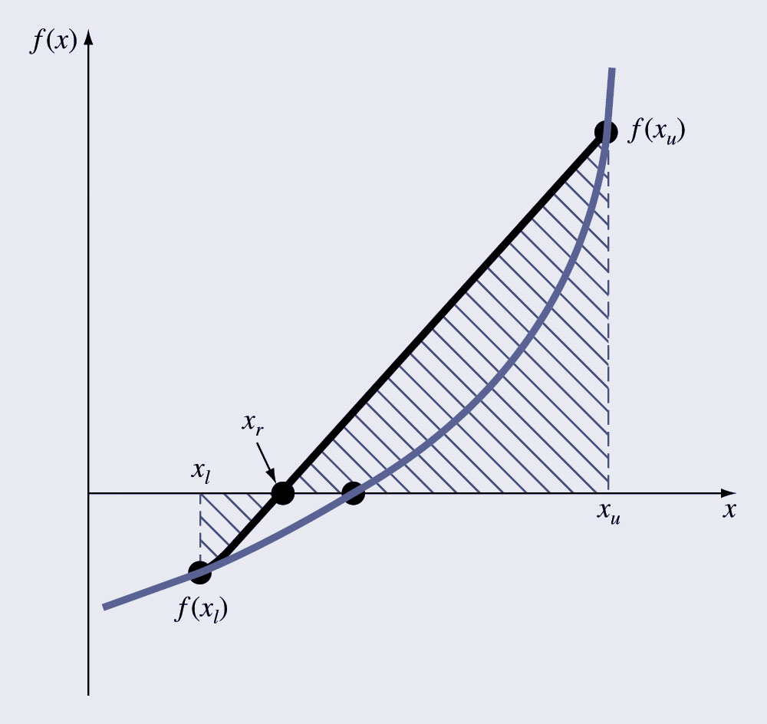
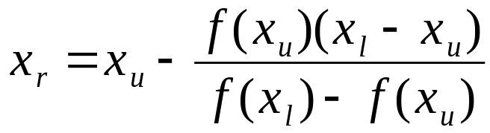
False Position Illustration

Slide 12

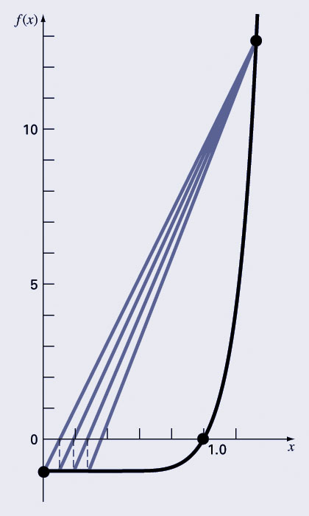
Bisection vs. False Position
Bisection does not take into account the shape of the function; this can be good or bad depending on the function!
Bad:

